Slide 1

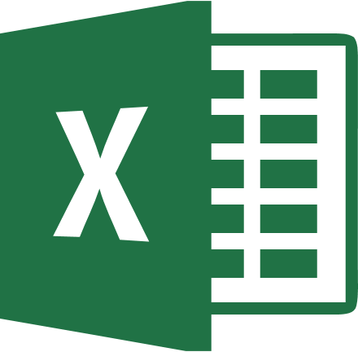
Bridging R and Excel Projects
Jameel Alsalam
May 16, 2018
EPA R Users’ Group

Slide 2

Jameel Alsalam
Economist, Office of Air and Radiation, Climate Change Division
Reports on U.S./int’l GHG emissions projections
Oil and gas regulatory impacts analyses
Me, pre-2015: Staring at Excel all day
Me, since 2016-ish: Staring at RStudio all day
R & tidyverse enthusiast

Slide 3

The R/Excel Divide
“On teams with both R and Excel users, how do we do our work?”
This Photo by Unknown Author is licensed under CC BY-SA

Slide 4
The R/Excel Divide (2)
R | Workflow Element | Excel
scripts | Approach | Point-and-click
Rmarkdown | Document Creation | Paste tables -> word
Git / Github | Collaboration | Sharepoint
scripts | Independent Components | workbook
Rstudio projects, packages | Combining Pieces Together | Links

Slide 5
Outline
Package landscape
(1) Excel as input
(2) Excel as output
(3) Collaboration workflows
My Questions
Notes:
Map of what I want to talk about

Slide 6
R/Excel Package Landscape
Many packages address this space
“a million ways to connect R and Excel”
readxl, writexl, openxlsx, RExcel, XLConnect, xlsx, gdata, RODBC, BERT, officeR, excel.link, WriteXLS, RDCOMClient, tidyxl

Slide 7
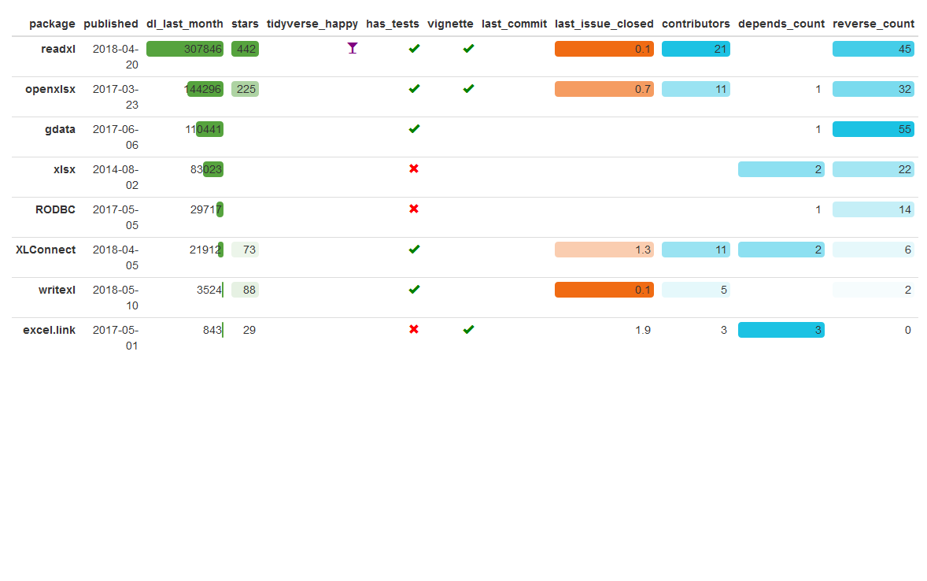
ropenscilabs/packagemetrics comparison
Blog post about the packagemetrics project: https://ropensci.org/blog/2017/06/27/packagemetrics/

Slide 8
My Favorites
Function | Package
Read in .xls/.xlsx data | readxl
Write output | openxlsx

Slide 9


Excel input with readxl
Alternate PPT title: “an ode to Jenny Bryan”
Great documentation: http://readxl.tidyverse.org/
.xls (legacy binary format through ~Excel 2007)
.xlsx (current XML-based format)
Webinar: What’s new with readxl (November 2017)
Vignette: readxl workflows
Focus is importing a data rectangle, does not expose formatting or other complex aspects of Excel files.

Slide 10
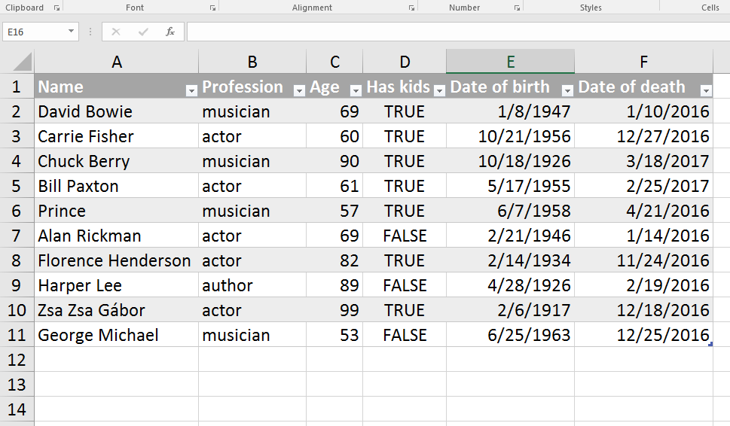
Ideal Spreadsheet has Data in Upper Left
Source: adapted from readxl example spreadsheet

Slide 11
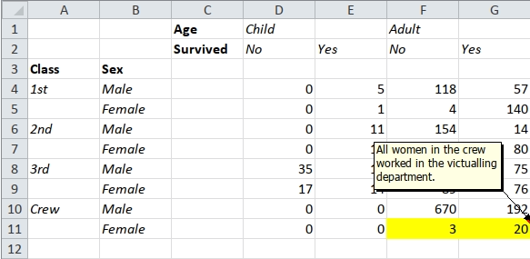
Spreadsheets Often Untidy
Source: tidyxl README

Slide 12
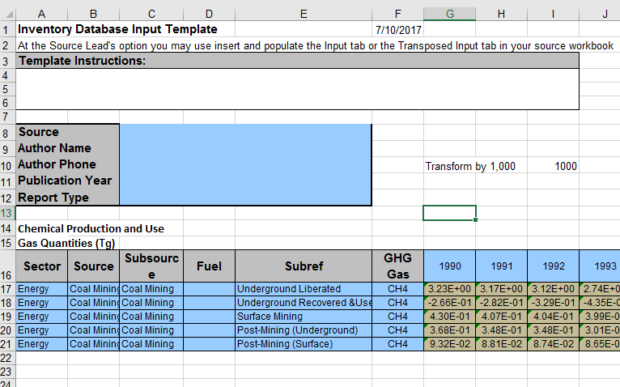
Structured Template
[old draft example from ongoing project]

Slide 13


Project Workflow: Many Spreadsheets
Spread-sheet
.xlsx templates
Organize spreadsheets with standardized output format
readxl + purrr to roll up standardized results from many analyses
Benefits from both Excel and R:
Individuals can work independently on their own workbooks
Perform updates of cross-cutting calculations quickly and easily by re-running the R script
[jump to deaths.xlsx and many-sheets.Rmd]

Slide 14
Pitfalls & Best Practices
Paper: Data Organization in Spreadsheets (Broman & Woo, 2017)
Webinar: Data Rectangling (Bryan, 2018)
Upgrade .xls -> .xlsx (Office Open XML specification)
Separate the sensitive data in encrypted files
Use a structured template
readxl can guess wrong type for mostly-blank columns
Stray notes/data can surprise
Design code to fail loudly when data doesn’t meet expectations

Slide 15
Excel as Output
I *like* the way Excel tables look.
Workflow 1: Raw output, formatting in Excel
Workflow 2: Full formatting w/openxlsx or XLConnect
[jump to Table 2-1.xlsx and simple-output.Rmd]

Slide 16
Other Approaches
(things I’ve only experimented with or read about)
Fully-formatted output with: openxlsx
Insert tables into word doc: officeR/flextable
Dependency-free output: writexl
Wrangle poorly-formatted data: tidyxl
Run Excel from R: RDCOMClient
Call R from Excel: Basic Excel R Toolkit (BERT)

Slide 17


Collaboration
Sharepoint v. Git/Github

Slide 18
Two Collaboration Workflows
#1 – All in Github repo
#2 – Github + Sharepoint
Store both data and code in repo
Pros:
Self-contained, reproducible analysis
Good if data files aren’t too large and don’t change too much
Cons:
Requires users to learn git
Git can’t diff Excel files
Data in sync’d Sharepoint; code in repo
Pros:
Different files in their ‘natural’ homes
Easier for non-git users
Cons:
Data and code are separated, less reproducible
More complex permissions/manage

Slide 19
My Questions
How do your teams work across R and Excel/Office?
Input:
How to access EPA Sharepoint directly (without syncing locally)?
A good way to work with password-protected files?
Output:
Make Excel output play nice with Git? (e.g., re-running shouldn’t trigger a file change)
Good approach to pretty-formatted tables?
How to update a Word doc with updated tables?

Slide 20
Thank you!
Jameel Alsalam (Alsalam.Jameel@epa.gov)

